Slide 1
Top 10 Restaurants in 8 Boroughs of Toronto by Rating and Likes

Slide 2
Introduction
Toronto is the capital city of the Canadian province of Ontario.
Its current area is 630.20 𝑘𝑚2 (243.3 square mile)
Population of 2,731,571 in 2016 (it is the most populous city in Canada and the fourth most populous city in North America)
It varies in culture and attract over 43 million tourists each year.

Slide 3
Introduction (continue)
If you're one of those (over) 43 million tourists, you might have many concerns when you visit Toronto. Project: Select top 10 restaurants in 8 boroughs (Downtown Toronto, West Toronto, East Toronto, Central Toronto, North York, Scarborough, East York, Etobicoke) of Toronto based on number of likes and rating restaurants from Foursquare.
Foursquare is a local search-and-discovery mobile app developed by Foursquare Labs Inc. It also has web app and API.

Slide 4
Data
Foursquare API: to get the most common restaurants of a given neighborhood of a borough.
Postal Code of Boroughs in Toronto: Postal code of neighbourhoods of a given borough in Toronto.
Neighbourhood Latitude and Longitude : Neighbourhood Latitude and Longitude of a given borough, used to obtain the most common restaurants in a given neighbourhood using Foursquare API.

Slide 5
Methodology
Technology Used
Data Extraction

Slide 6
Technology Used
Numpy: Scientific Computing library for Python
Pandas: Data manipulation and analysis
Matplotlib: Visualization
requests: API operations
Nominatim: Convert location name to Latitude and Longitude
folium: Visualize data on map

Slide 7
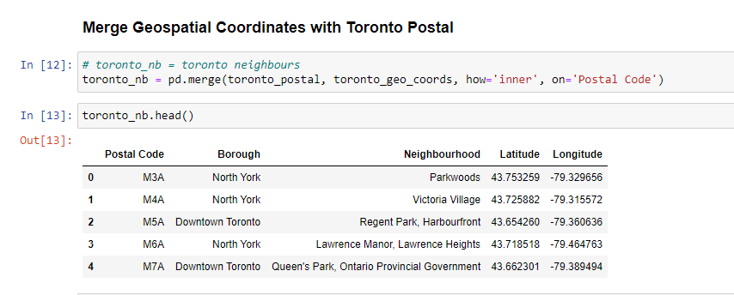
Data Extraction
Toronto’s Neighborhoods – Latitude and Longitude

Slide 8
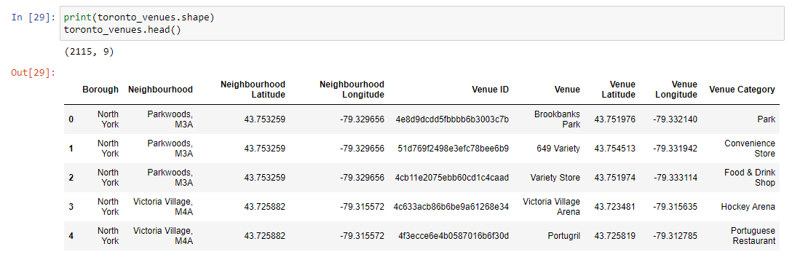
Data Extraction (continue)
Toronto’s Neighborhoods – Venues

Slide 9
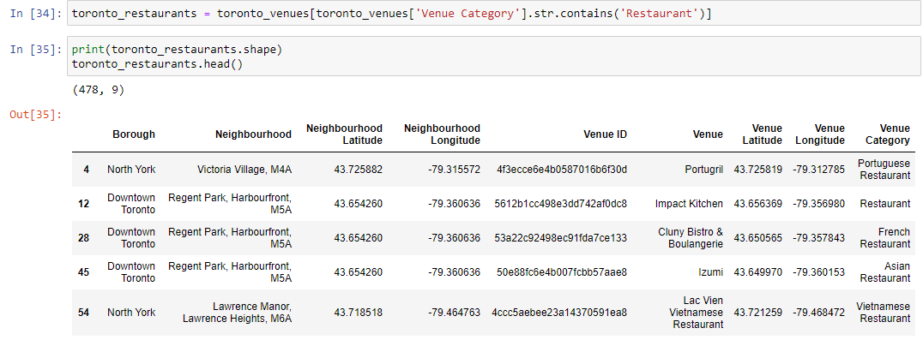
Data Extraction (continue)
Toronto’s Neighborhoods – Restaurants

Slide 10
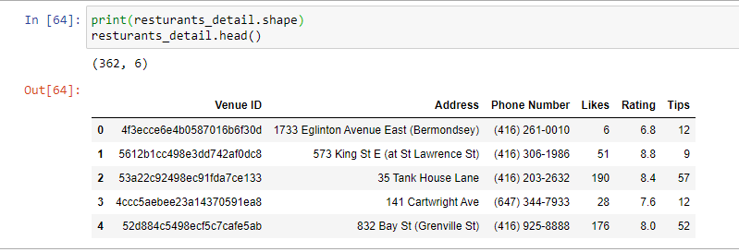
Data Extraction (continue)
Toronto’s Neighborhoods – Restaurants’ Detail

Slide 11
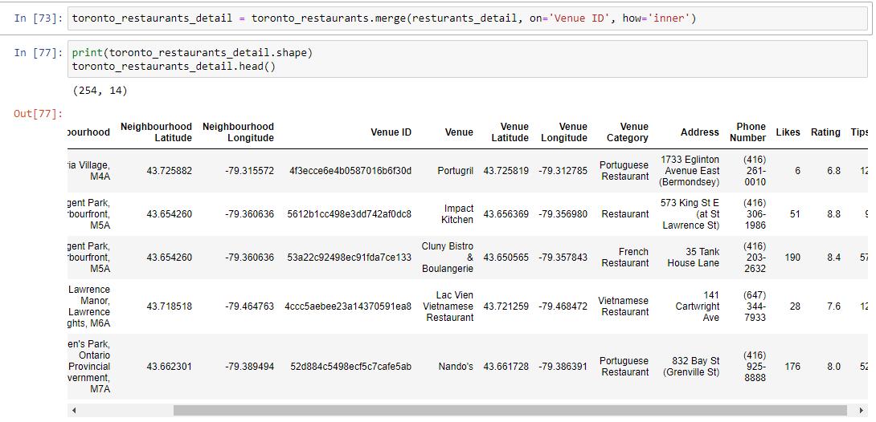
Data Extraction (continue)
Toronto’s Neighborhoods – Restaurants’ Detail in each borough

Slide 12
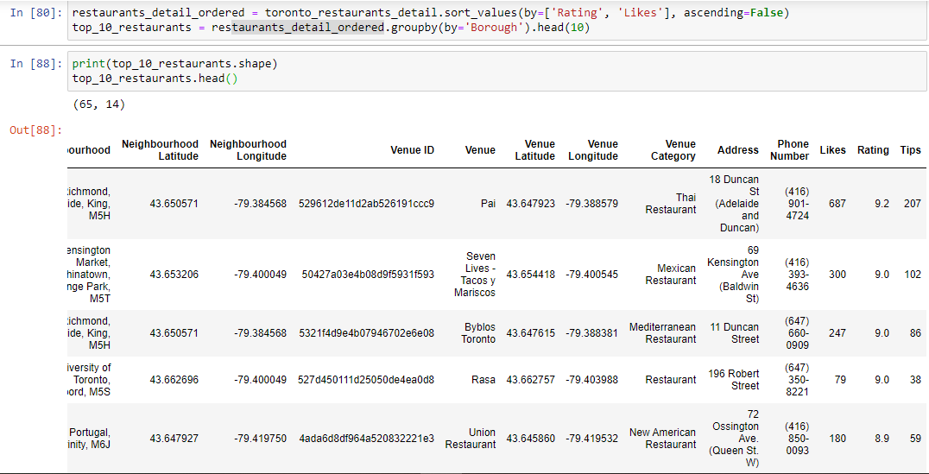
Data Extraction (continue)
Toronto’s Neighborhoods – Top 10 Restaurants in each borough

Slide 13
Result
Downtown Toronto, West Toronto, East Toronto, Central Toronto, North York, Scarborough, East York, Etobicoke
Some boroughs have less than 10 restaurants
Boroughs with 10 or more restaurants - top 10 restaurants
Beside this - top restaurants.

Slide 14
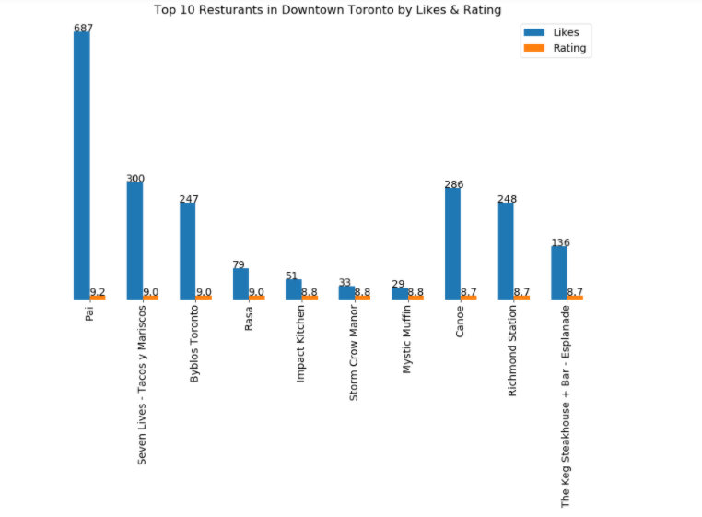
Downtown Toronto

Slide 15
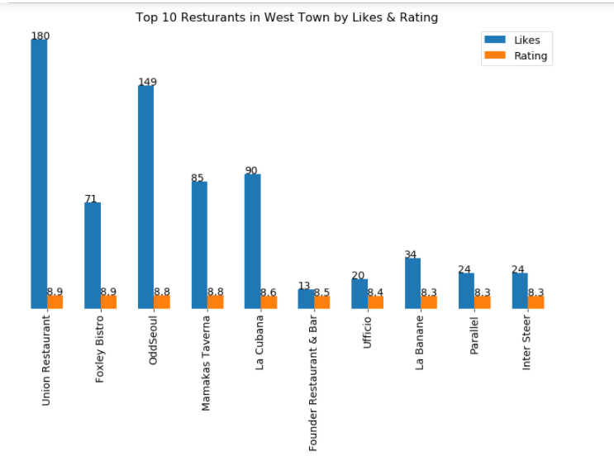
West Toronto

Slide 16
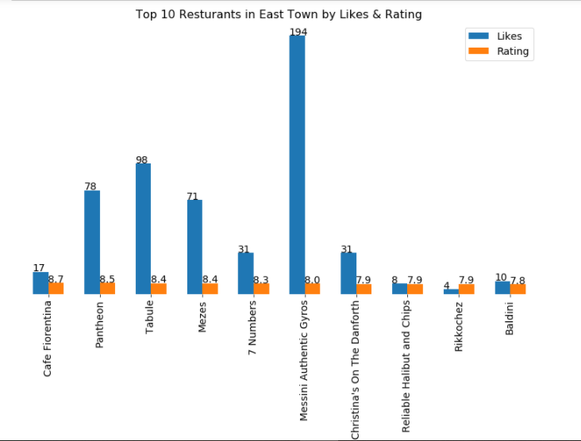
East Toronto

Slide 17
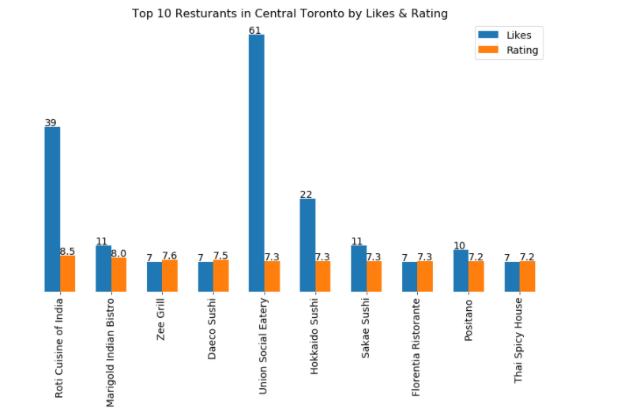
Central Toronto

Slide 18
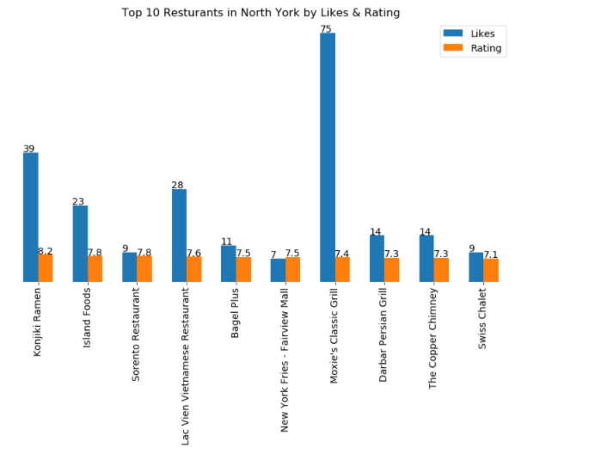
North York

Slide 19
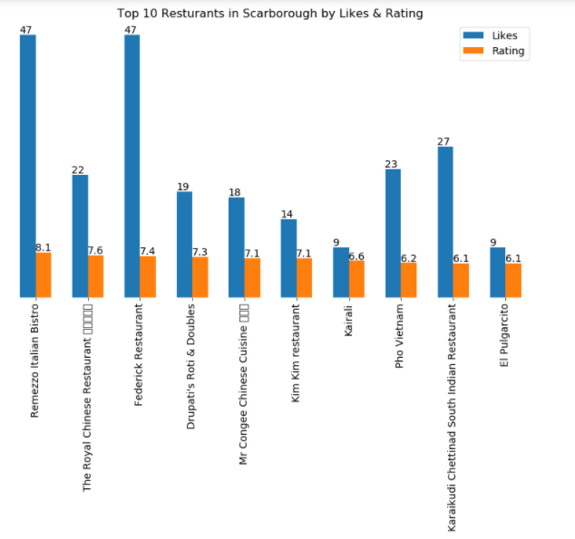
Scarborough

Slide 20
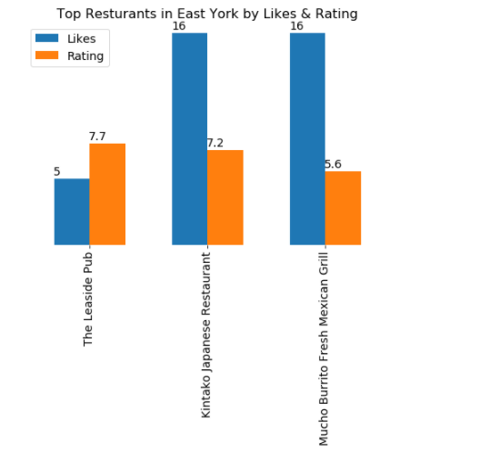
East York

Slide 21
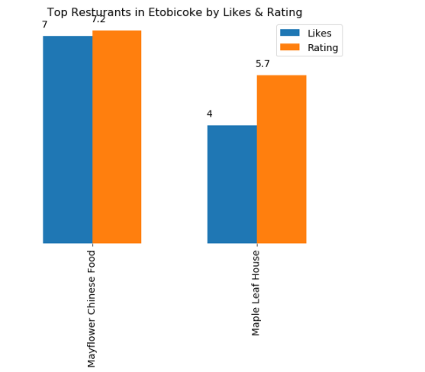
Etobicoke

Slide 22
Discussion
Drawback - For some boroughs, there are less than 10 restaurants.
Toronto itself varies in culture. It attracts millions of people every year. Further analysis with different API to explore more.
Base on Foursquare API, although it is not complete, this might give us a pretty good idea of restaurants in Toronto and its boroughs. The reason is the data is based on people.

Slide 23
Conclusion
Starting by introducing of problem, then describe needed data, walkthrough methodology, get the results, and finally the discussion of whether the project is helpful. I hope this gives help target audients in deciding of choosing restaurants in each boroughs and Toronto overall.

Slide 24
Future Work
Try different API
Discover top restaurants in different category (Italian, Japanese...)
find out, overall, which borough has better restaurants (Likes and Rating)
Examine tip(review) from user

Slide 25
Thank You

